Slide 1
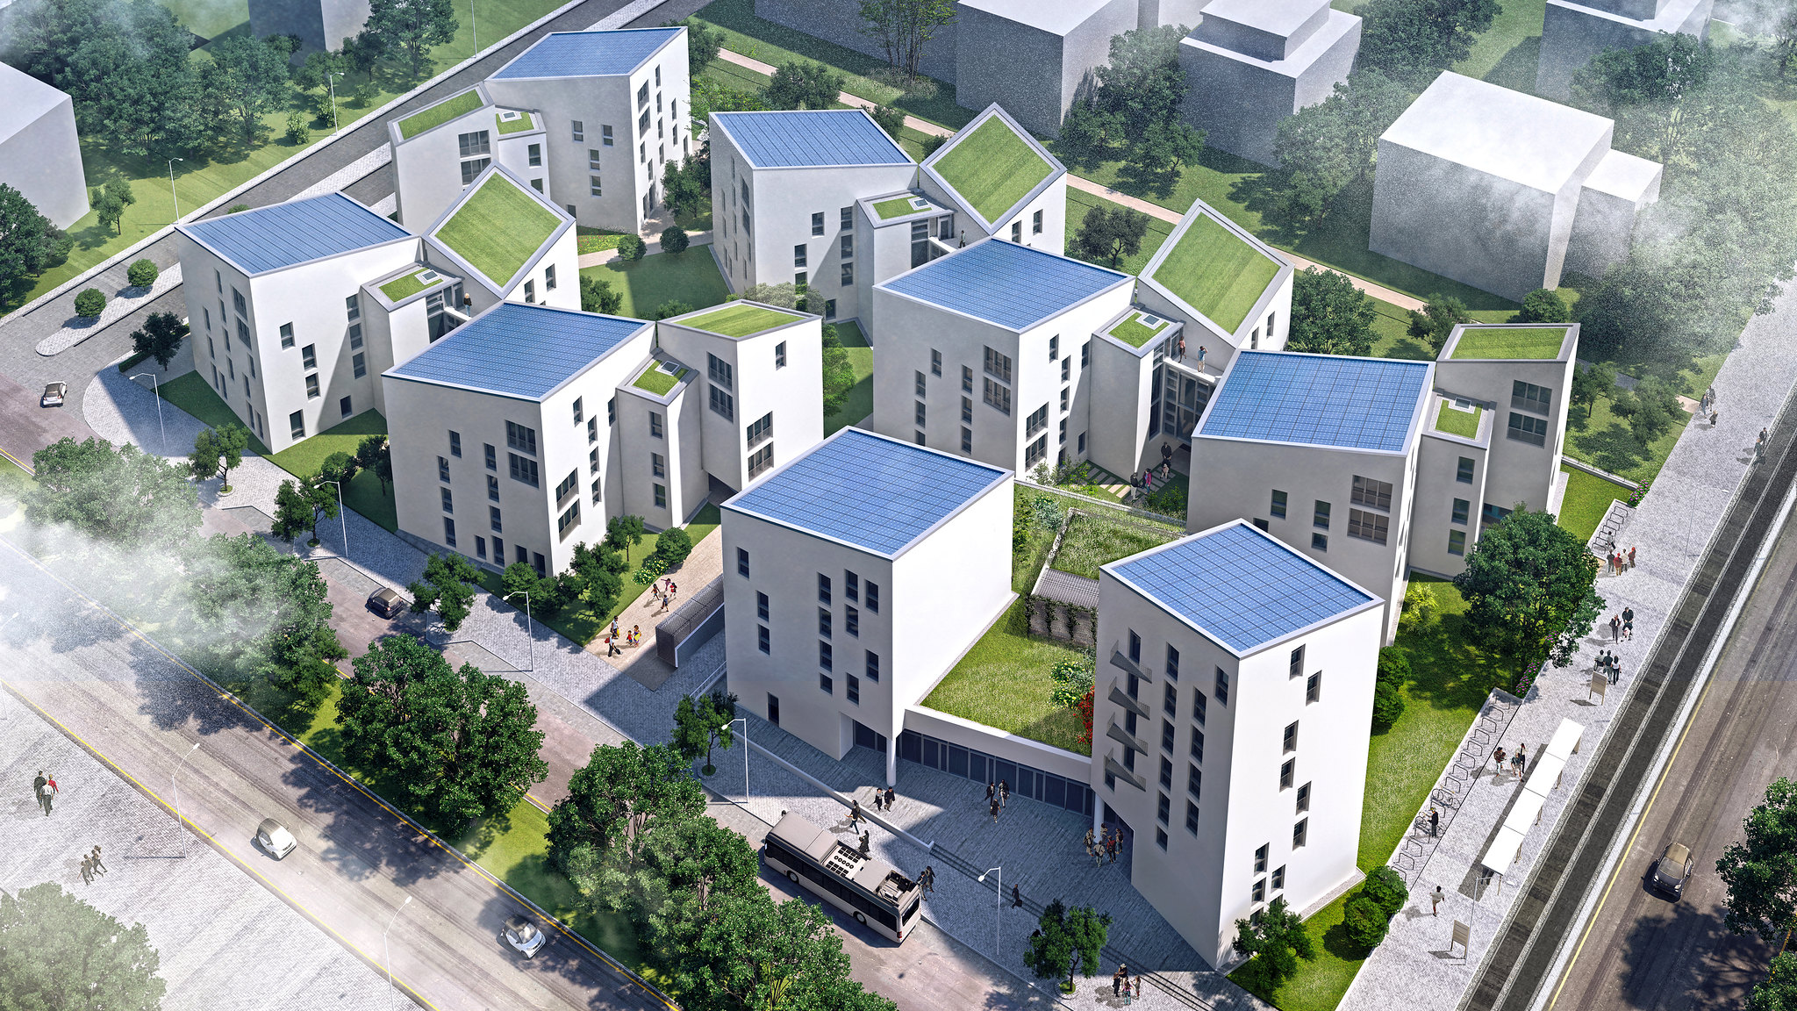
HOUSING: PRICE PREDICTION PROJECT
Submitted by:
PRANJAL DIKONDA

Slide 2
TABLE OF CONTENTS
INRODUCTION –
• Business Problem Framing
• Conceptual Background of the Domain Problem
• Review of Literature
• Motivation for the Problem Undertaken
Analytical Problem Framing –
• Mathematical/ Analytical Modeling of the Problem
• Data Sources and their formats
• Data Preprocessing Done
• Data Inputs- Logic- Output Relationships
• Hardware and Software Requirements and Tools Used

Slide 3
TABLE OF CONTENTS
Exploratory Data Analysis
Univariate analysis
Categorical data visualization
Numerical data visualization
Bivariate analysis
Multivariate analysis
Model/s Development and Evaluation
Identification of possible problem-solving approaches (methods)
Testing of Identified Approaches (Algorithms)
Run and Evaluate selected algorithms
Key Metrics for success in solving problem under consideration
Visualizations
Interpretation of the Result

Slide 4
TABLE OF CONTENTS
CONCLUSION
• Key Findings and Conclusions of the Study
• Learning Outcomes of the Study in respect of Data Science
• Limitations of this work and Scope for Future Work

Slide 5
INTRODUCTION

Slide 6
Business Problem Framing
Houses are one of the necessary need of each and every person around the globe and therefore housing and real estate market is one of the markets which is one of the major contributors in the world’s economy. It is a very large market and there are various companies working in the domain. Data science comes as a very important tool to solve problems in the domain to help the companies increase their overall revenue, profits, improving their marketing strategies and focusing on changing trends in house sales and purchases. Predictive modelling, Market mix modelling, recommendation systems are some of the machine learning techniques used for achieving the business goals for housing companies. Our problem is related to one such housing company.
We have to make a machine learning model by using some independent variable and predict the house price of particular variables.

Slide 7
Conceptual Background of the Domain Problem
Real estate market is one of the markets which is one of the major contributors in the world’s economy.There is some sharp change in the real estate market of some countries as with the time ,value of property is increasing.
The main cause for the increase of real estate market is the increase in population. As the population increase demand for property also increase.
Residental property is more costly than commercial as there is the role of demand and supply.
Similarly the price of property also depends on nearby social and economic conditions of property like the neighbourhood, crime rate, basic facilities like sewrage, freshwater,parks etc.

Slide 8
Review of Literature
We are going to work on the dataset provided for building a model to predict the nature of future customers –
a. Uploading the dataset
b. Data -preprocessing, removing unnecessary features
c. Exploratory analysis of features
d. Visualisaton of features, features along with target feature
e. Data cleaning by removing outliers or missing values treatment
f. Model pre-processing and model training
g. Tesing multiple algorithms with multiple evaluation metrics
h. Using the evaluation metrics best suited for our problem
i. Hyper-parameter tuning using RandomisedSearchCV for the
best model parameter
j. Model prediction
k. Saving the final model

Slide 9
Motivation for the Problem Undertaken
Every person needs a house to live. But not all of them able to find suitable match for their requirements. Due to the rise in property rates day by day ,it becomes hard for people to get a house in their budget and even for the companies to form a better strategy to focus on customers without knowing them well.
Data science comes as a very important tool to solve problems in the domain to help the companies increase their overall revenue, profits, improving their marketing strategies and focusing on changing trends in house sales and purchases. Predictive modelling, Market mix modelling, recommendation systems are some of the machine learning techniques used for achieving the business goals for housing companies. Our problem is related to one such housing company.

Slide 10
Analytical Problem Framing

Slide 11
Mathematical/ Analytical Modeling of the Problem
In this project we have used mathematical and stastistical methods to find the best result out of the data.
Firstly, we are using descriptive analysis to find the information about mean ,median, percentiles ,standard deviation ,minimum and maximum values.
Then we find the descriptive analysis of Target variable i.e. “SalePrice”.
After that by using the correlation method ,we find the correlation percentage between target variables and independent variabels. We draw a table which gives the correlation of each variable with each other.

Slide 12
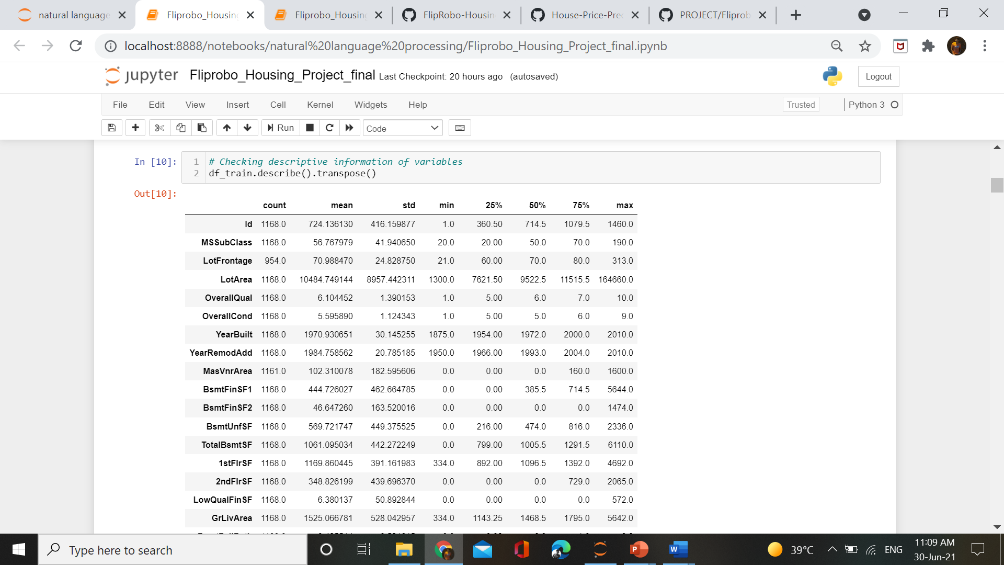
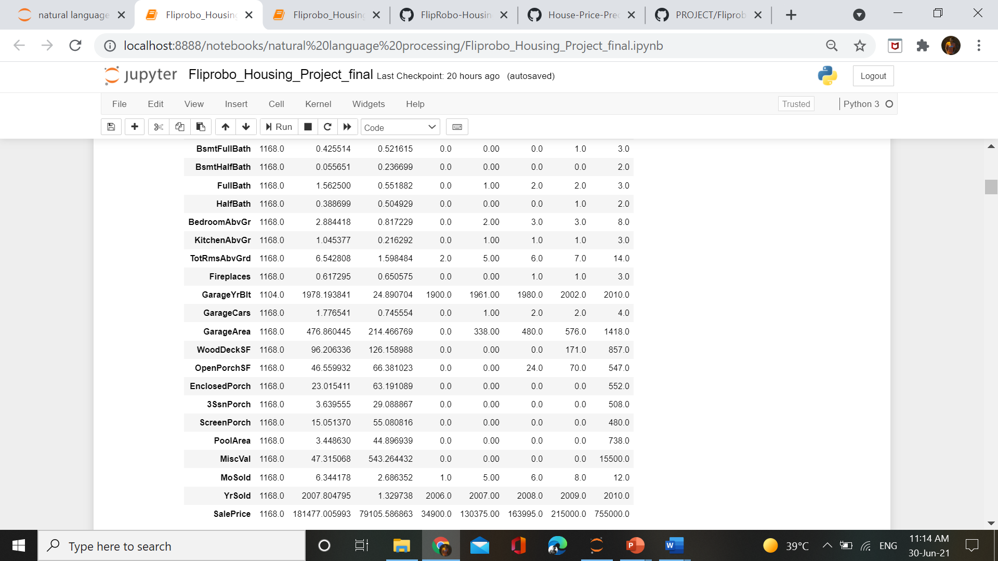
Descriptive Analysis

Slide 13
Descriptive Analysis
1. `MasVnrArea, BsmtFinSF2, BsmntHalfBath, BsmtfullBath, HalfBath, 2ndFlrSF, LowQualFinSF, WoodDeckSF, EnclosedPorch, 3SsnPorch, ScreenPorch, MiscVal` are having mean equal to 0 and mean greater than 0(in some cases far greater than 0) which clearly suggests the presence of many outliers along with high positive skewness in the variable.
2. `OpenPorch, GrLivArea, 1stFlrSF, TotalBsmtSF, BsmtUnfSF, BsmtFinSF1, MsSubClass, LotArea ` these variables having mean greater than median which shows positive skewness present in variables with some outliers.
3. `MiscVal, PoolArea, ScreenPorch, 3SsnPorch, EnclosedPorch, BsmtHalfBath ` Some variables having `minimum values 0, 25th percetile also 0, and some upto 75th percentile values equal to 0` while 100th percentile is far greater than zero..

Slide 14
Descriptive Analysis
4. `LotArea` having highest standard deviation `8957.442311` which means that data not normally distributed.
5. There is `huge difference in variables values`. Some having `small range values while some high range` values. It may impact the model efficiency if we use the dataset without scaling in proper format.

Slide 15
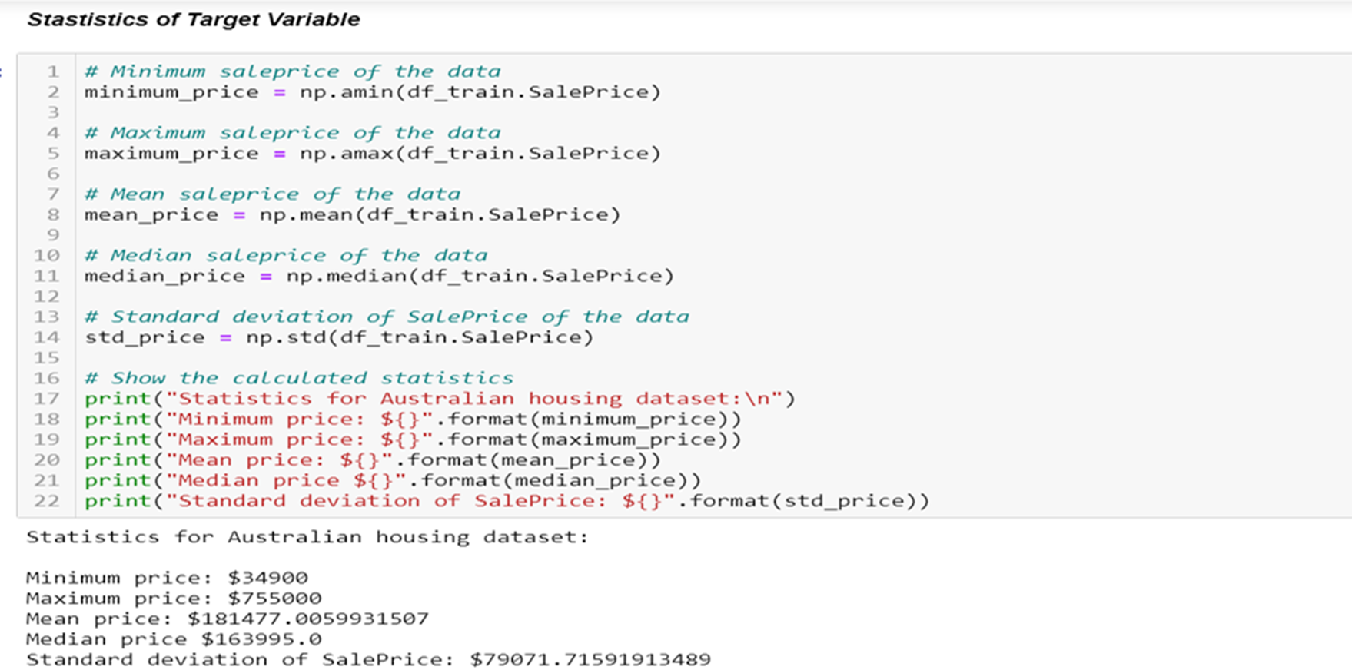
Descriptive Analysis of Target Variable

Slide 16
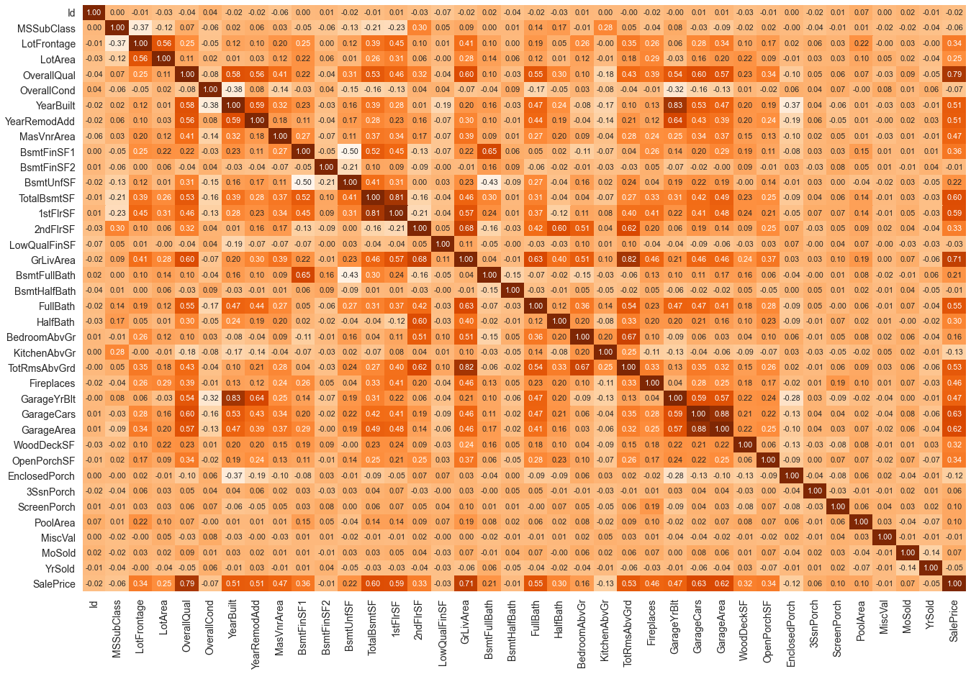
Descriptive Analysis of Variables -Correlation

Slide 17
Descriptive Analysis of Variables - Correlation
Observations :
OverallQual (Overall quality) is the highest correlated variables among all. It is `80% directly` correlated with the target variable, which means that the increase in OverallQual of house will going to increase the SalePrice of house or vice-versa.
After OverallQual, `GrLivArea (Grid Living Area)` is in more than `70% direct` correlation with target variable.
Almost all the variables with some correlation above `20%-30%` are in direct relationship with target variable.
Some variables like `KitchenAbvGr, EnclosedProch,` etc are indirectly correlated with Target variable but the degree of correltaion is very low.

Slide 18
Descriptive Analysis of Variables - Correlation
While some cases are present where there is high direct and indirect relationship between independent variables. It will create a problem of multicollinearity and it may distort our model efficiency.
*Variables like `GarageYrBuilt` and `YrBuilt` are having above 80% of direct correlation.
`TotalRmsAbvGrd and GrLivArea` also having 80% direct correlation.
` GarageArea and GarageCars` having 88% direct correlation.
While `BsmntUnf and BsmtFinSf1` having 50% indirect correlation with each other.
BsmntFullBath and BsmntUnf` having 43% of indirect correaltion with each other.

Slide 19
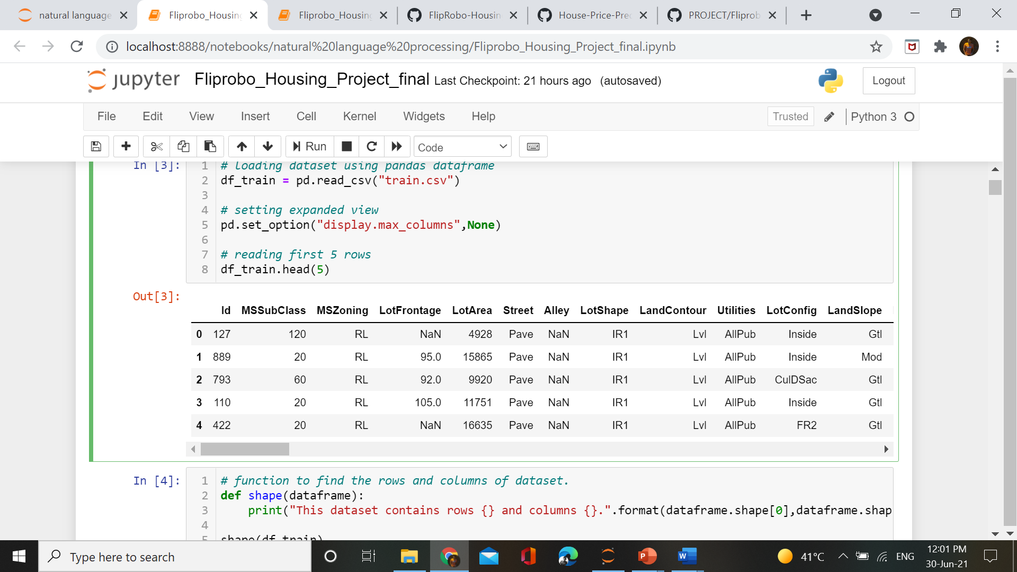
Data Sources and their formats
Now our data source is FlipRoboTechnologies, who provided the data in csv format during my internship program.
We loaded the data using pandas library.

Slide 20
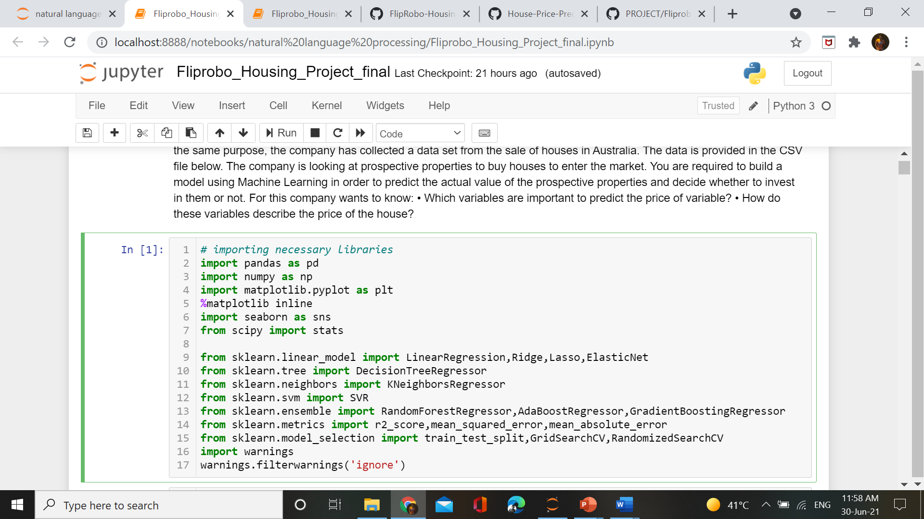
Data Sources and their formats
First of all before loading the data from source we imported the required libraries for our project.

Slide 21
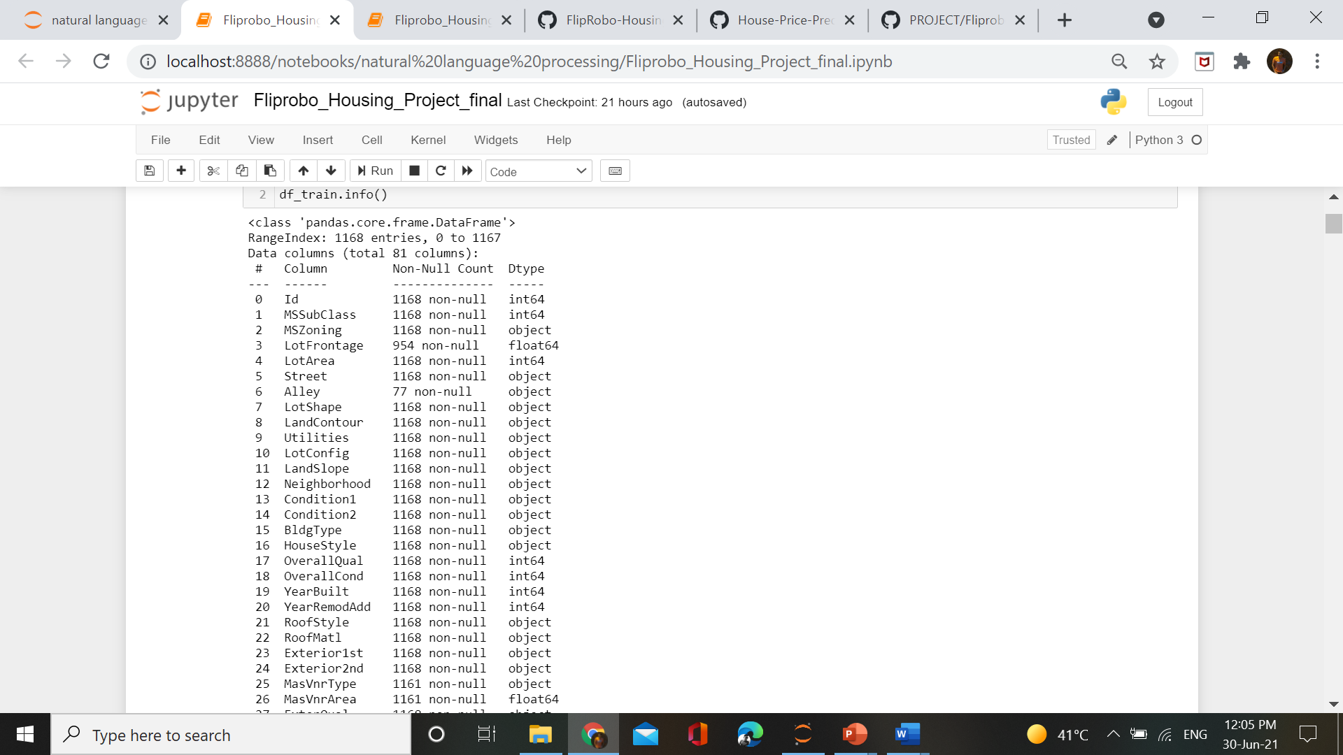
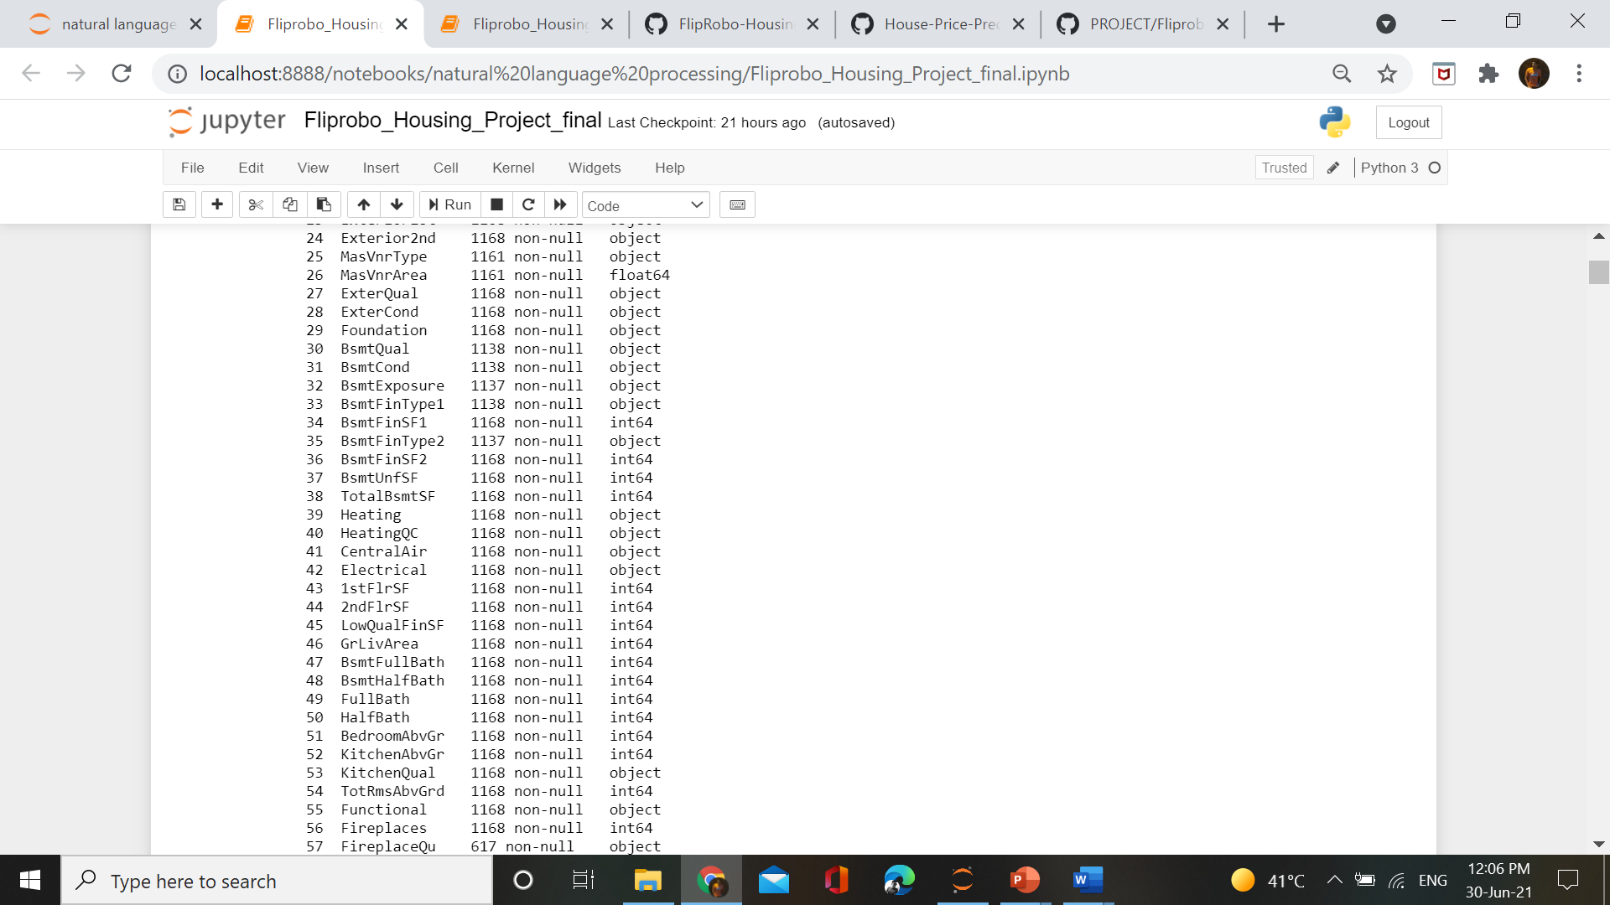
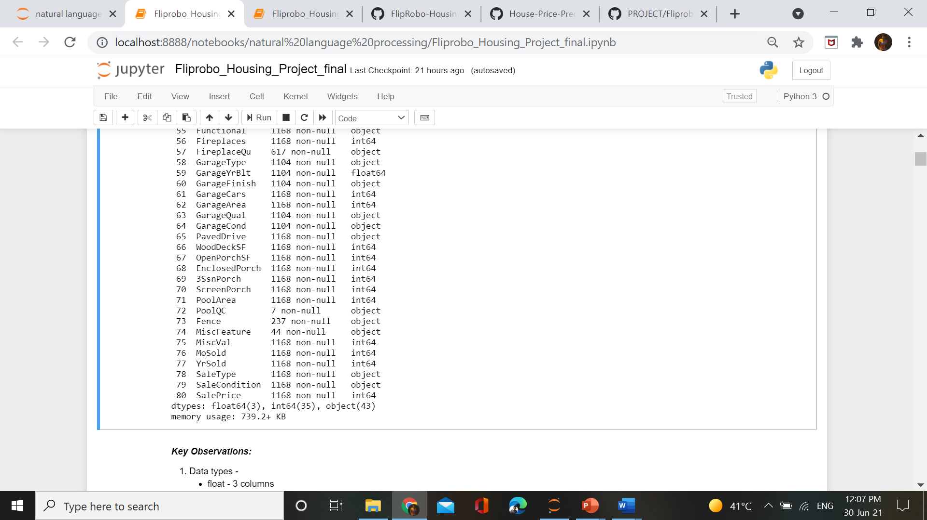
Data Sources and their formats

Slide 22
Data Sources and their formats
Data types present in dataset :
float - 3 columns
integer64 - 35 columns
object - 43 columns
Some of the columns contains null values

Slide 23
Data Preprocessing
In data preprocessing, various steps are there –
Checking the shape
Checking null values
Data Cleaning –
Filling null value
Dropping unnecessary columns

Slide 24
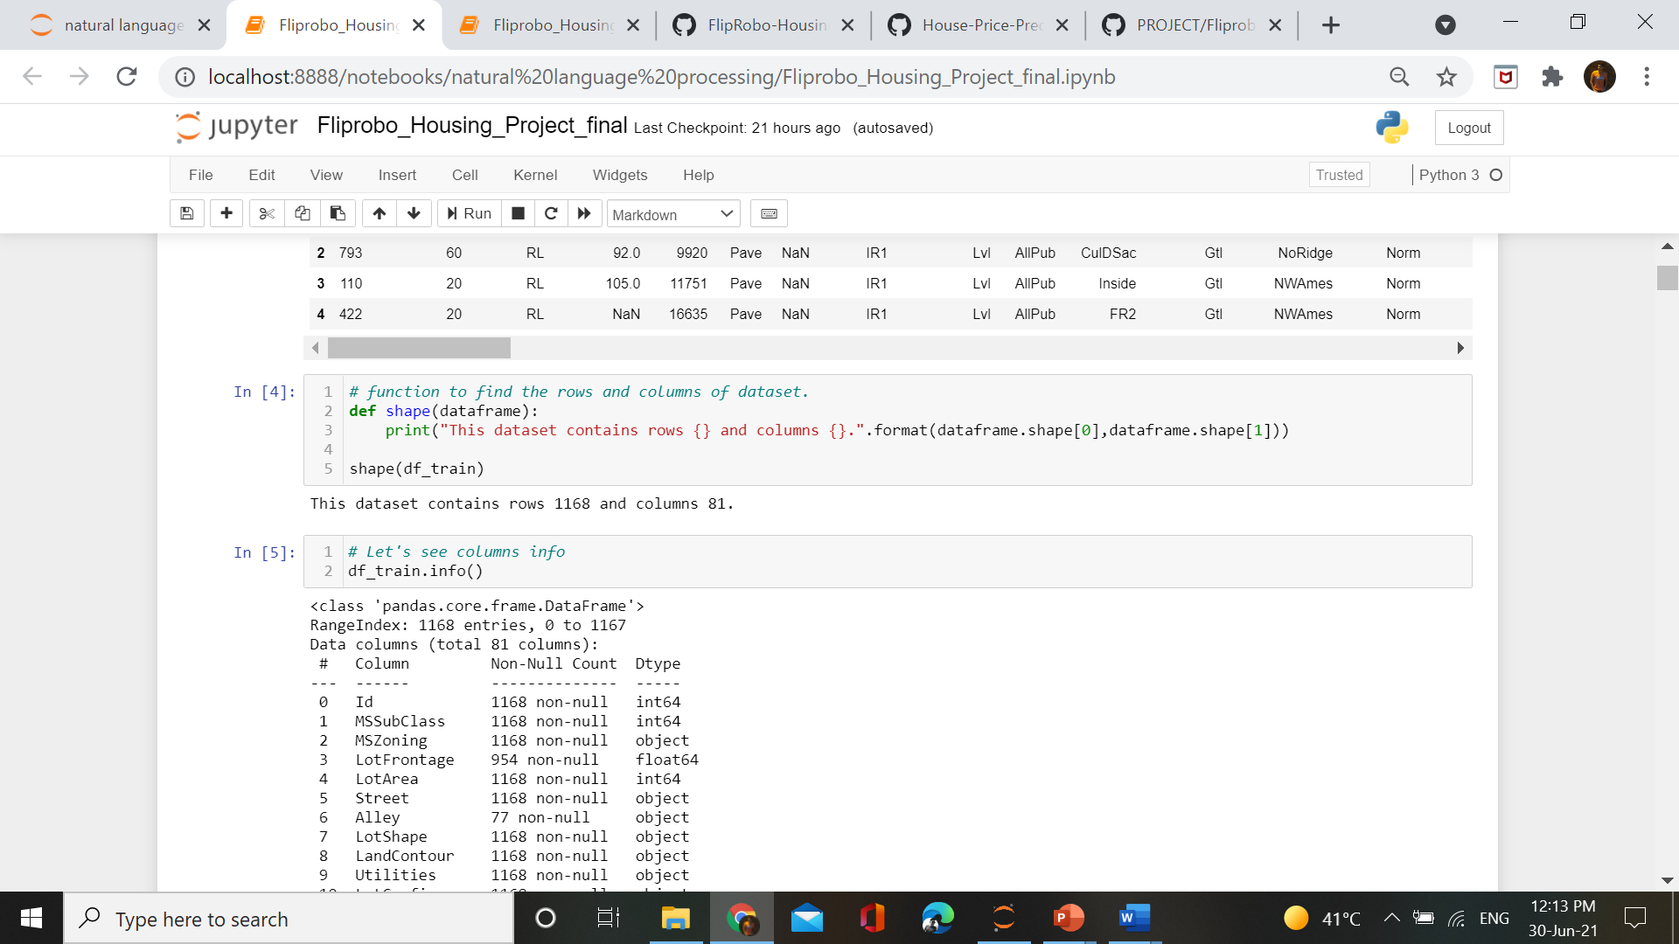
Data Preprocessing
Checking the shape of dataset :
So our train dataset contains 1168 columns and 81 rows.

Slide 25
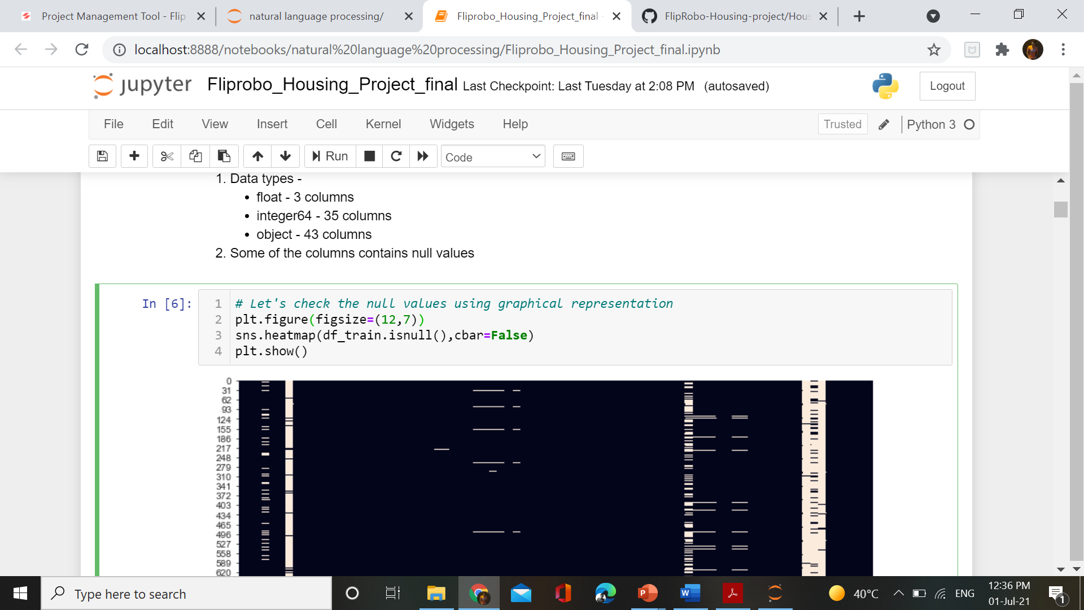
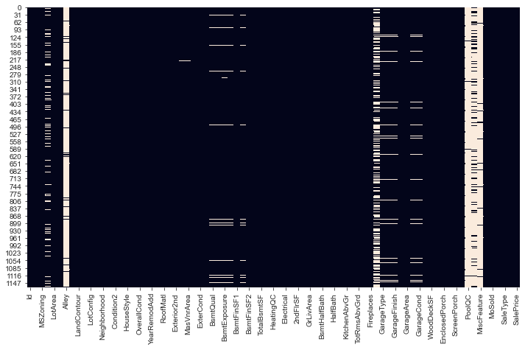
Data Preprocessing
Checking null values in dataset using heatmap

Slide 26
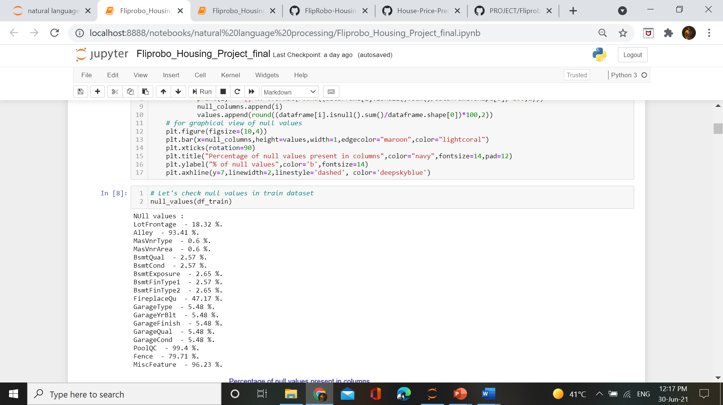
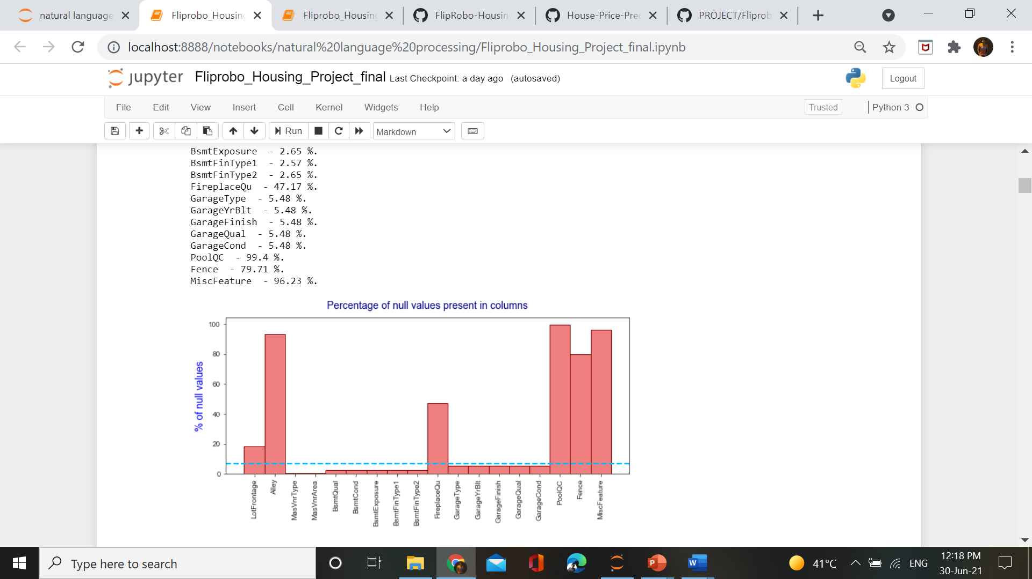
Data Preprocessing
Finding the percentage of null values

Slide 27
Data Preprocessing
Observations :
* from above we can clearly see that 4 variables contains null values more than 80% of total data.
* PoolQC contains null values - 99.4 %
* MiscFeature contains null values - 96.23 %
* Fence contains null values - 79.71 %
* Alley contains null values - 93.41 %
* While the blue line is drawn at 7% of missing values, below this line we can drop the missing values and it will not impact our prediction so much, but dropping above it will be more data loss which will not be suitable for our model.
* So 9-10 variables contains missing values less than 7%.

Slide 28
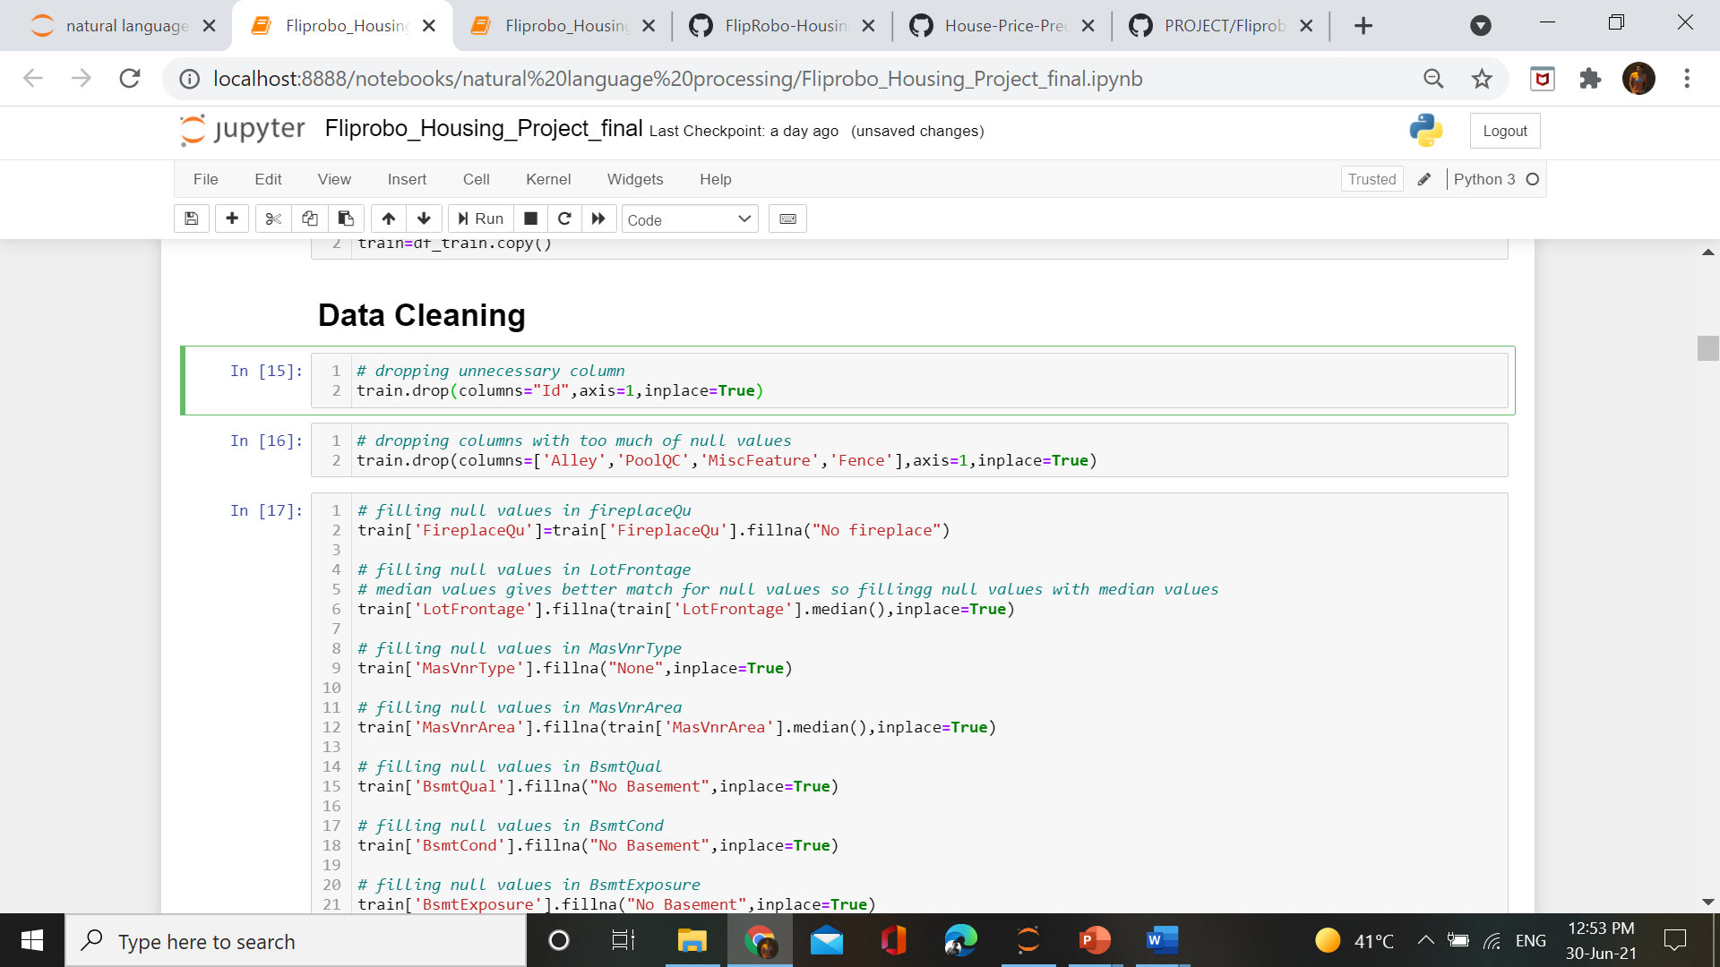

Slide 29
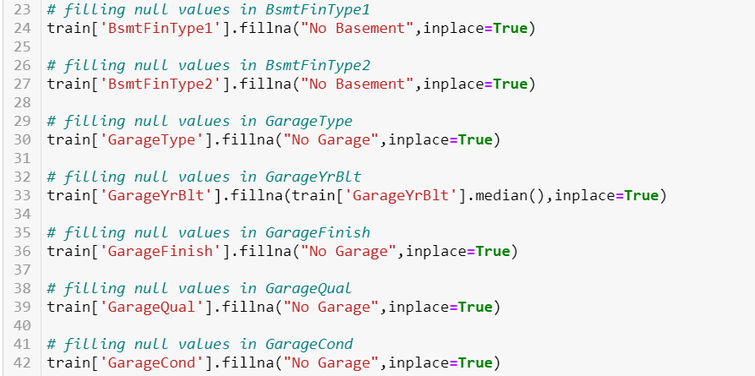

Slide 30
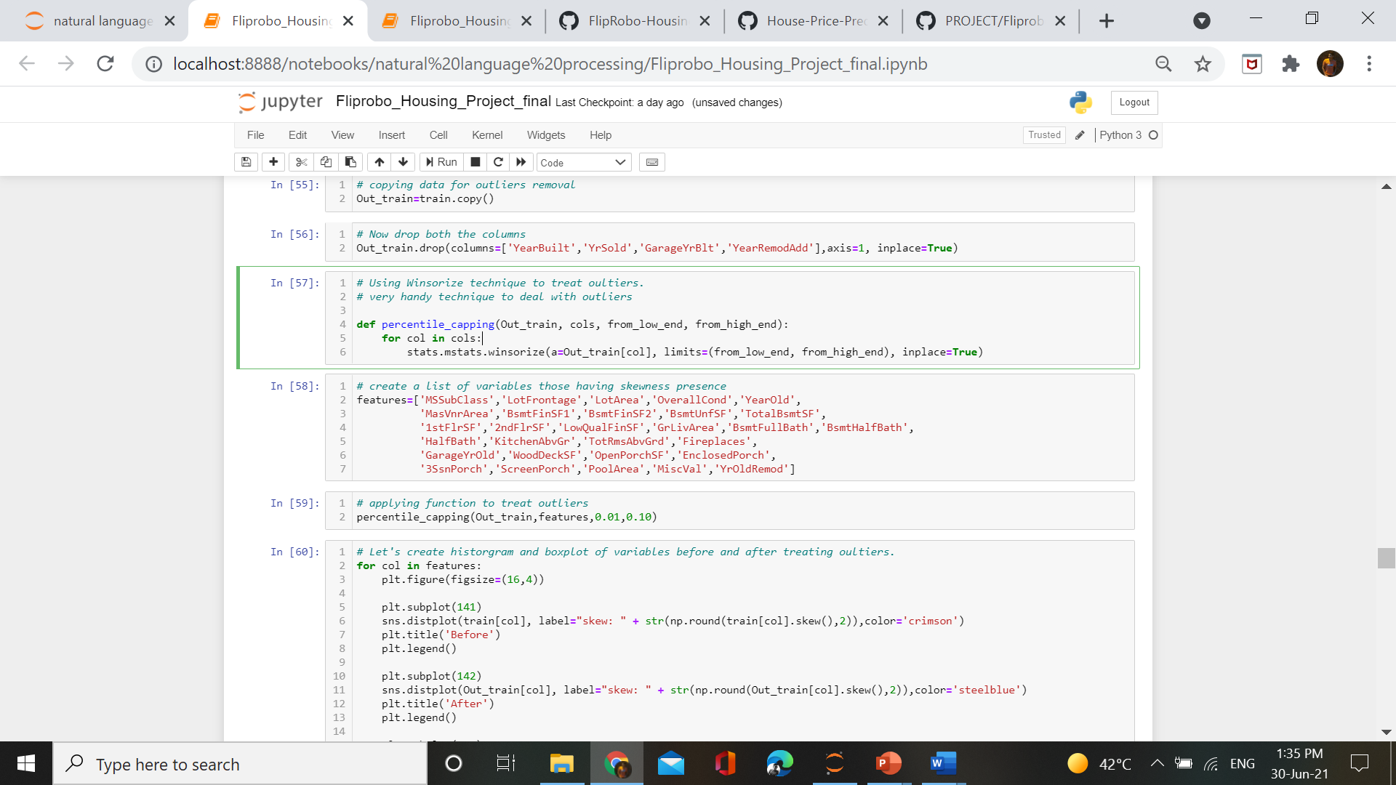
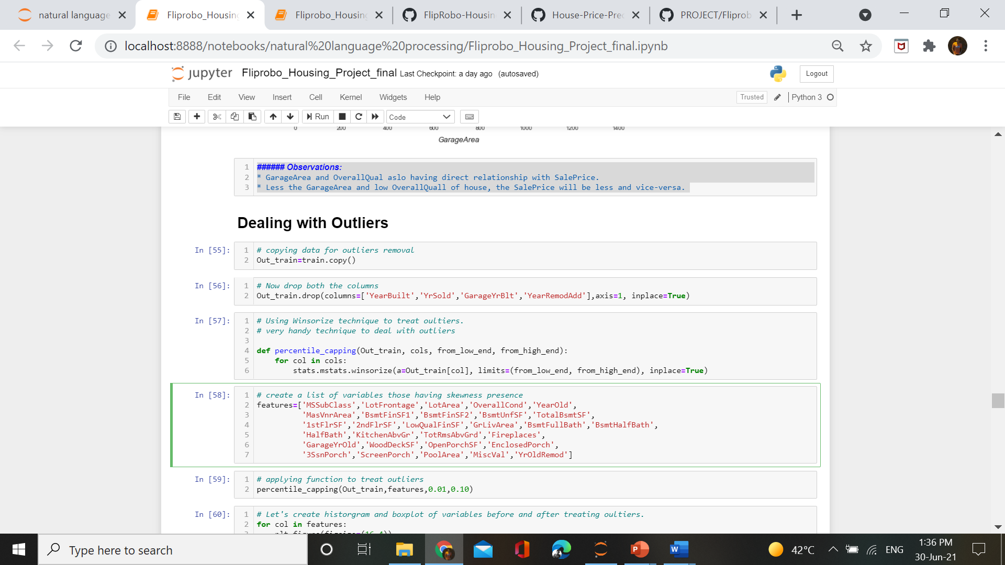
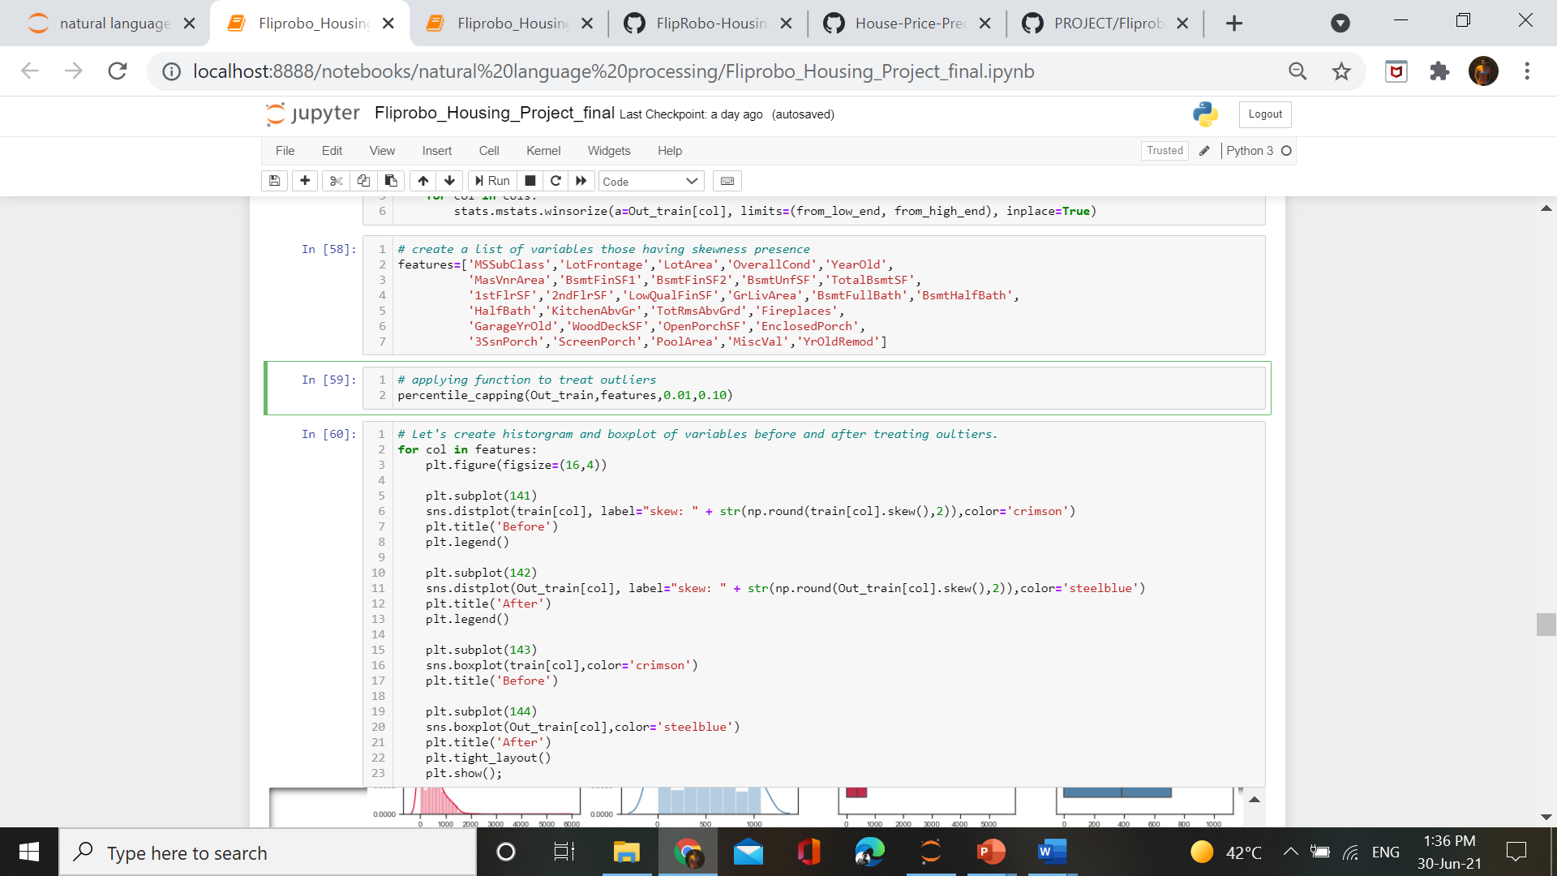
Data Preprocessing
Dealing with outliers – Using winsorize method to deal with outliers

Slide 31
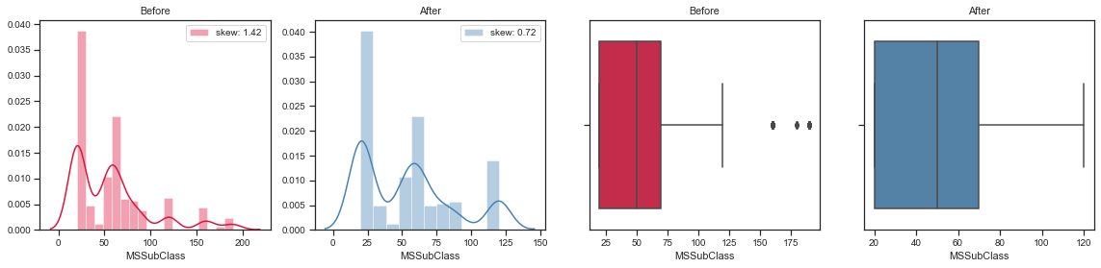
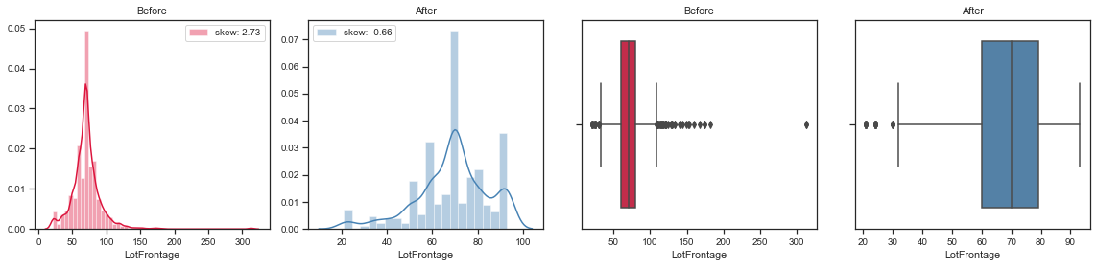
Data Preprocessing –Outliers Treatment

Slide 32
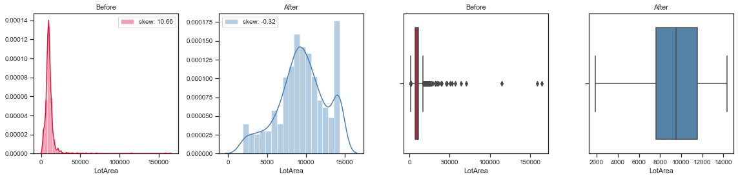
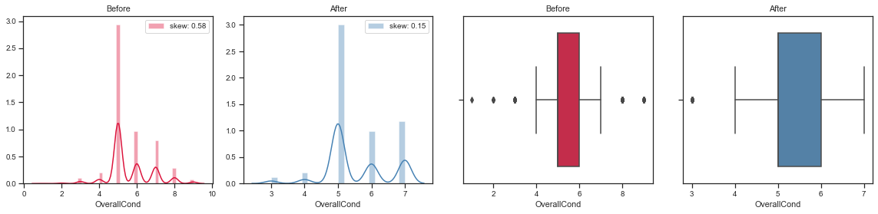
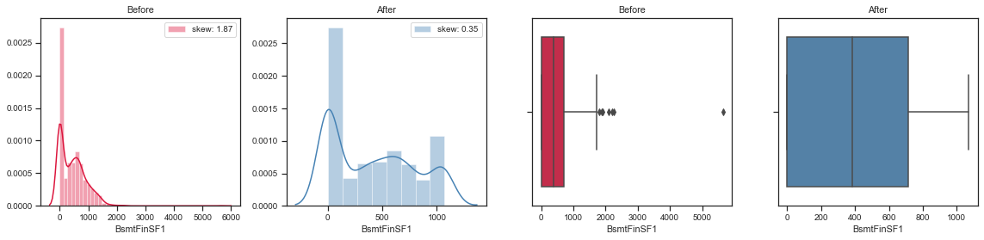

Slide 33
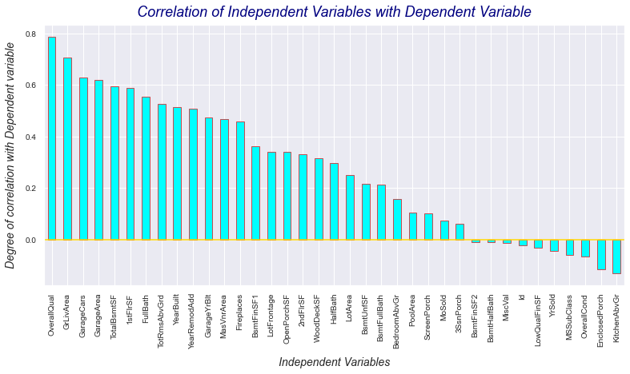
Data Inputs- Logic- Output Relationships

Slide 34
Data Inputs- Logic- Output Relationships
Observations :
As seen using heatmap, OverallQual is the most correlated variable with target variable and then GrLivArea ,GarageCars ,GarageArea etc.
Number of KitchenAbvGr will signify that there is indirect relationship with target variable. More the number less will be the SalePrice. Through it we can say that people will not prefer more kitchen above grounds.
Variables like BsmtHalfBath, BsmtFinSF2, MiscVal and id are having no relationship with target variable.

Slide 35
Hardware and Software Requirements and Tools Used
There is no such requirement for hardware ,but I have used intel i5 8th
generation processor.
Software: Jupyter Notebook (Anaconda 3), Microsoft Word, MicrosoftPowerPoint
Language: Python
Libraries used in project:
Pandas
Numpy
Matplotlib
Seaborn
Sklearn
Stats

Slide 36
Exploratory Data Analysis

Slide 37
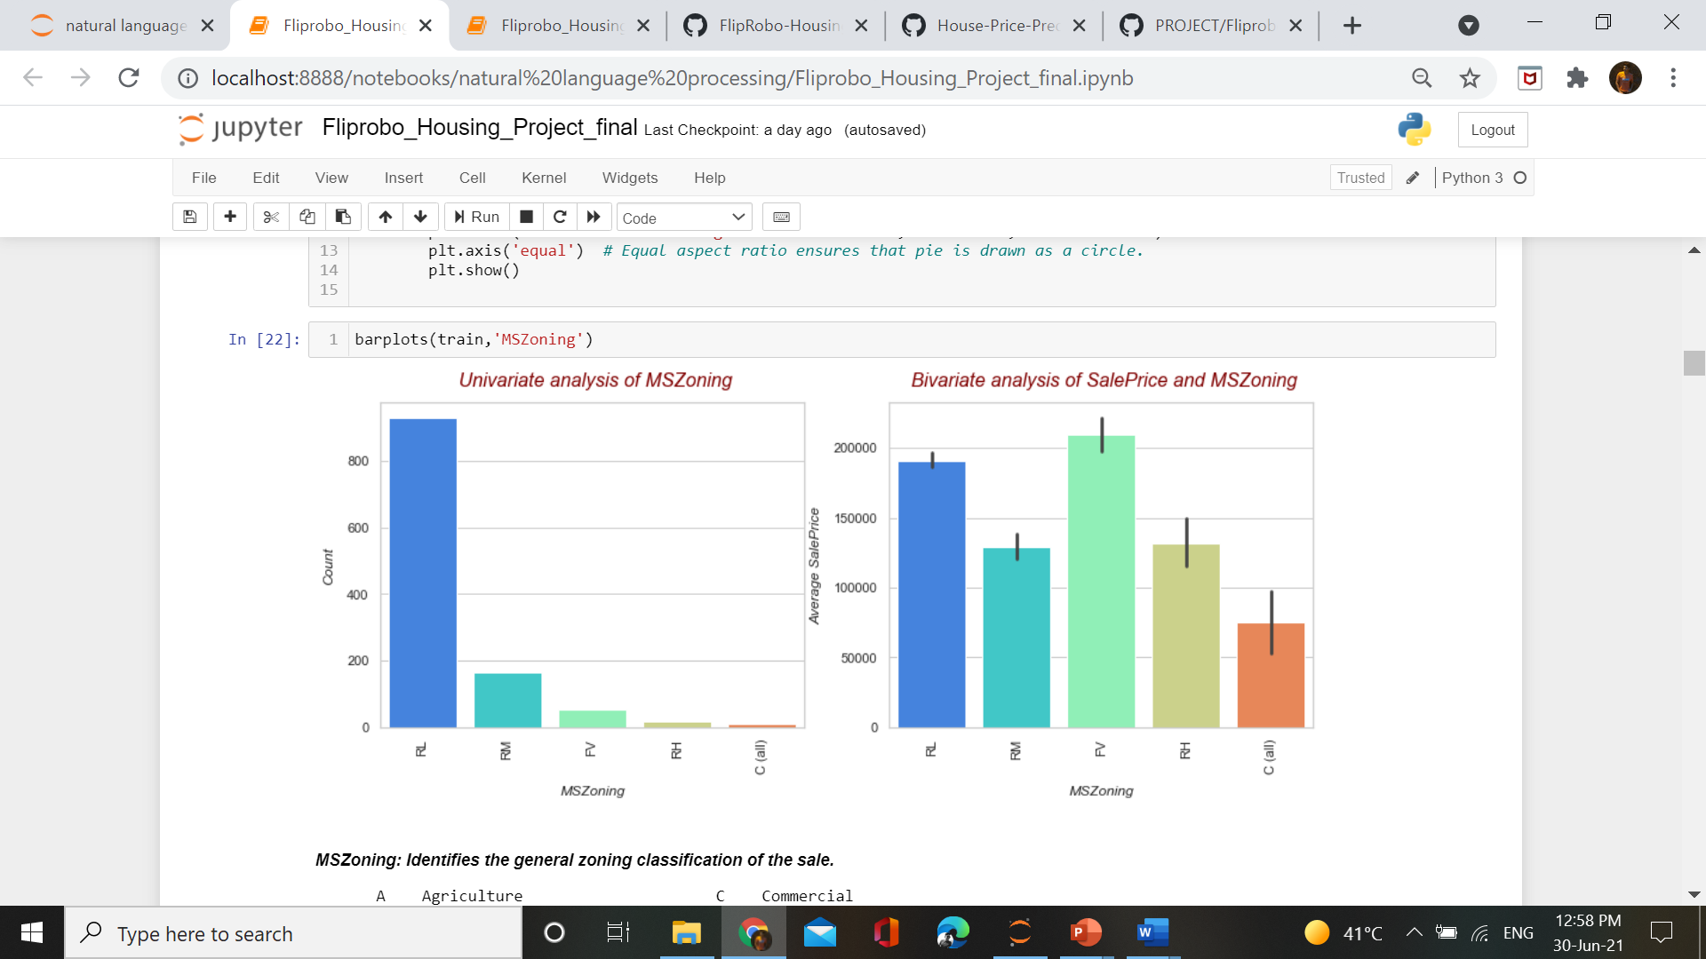
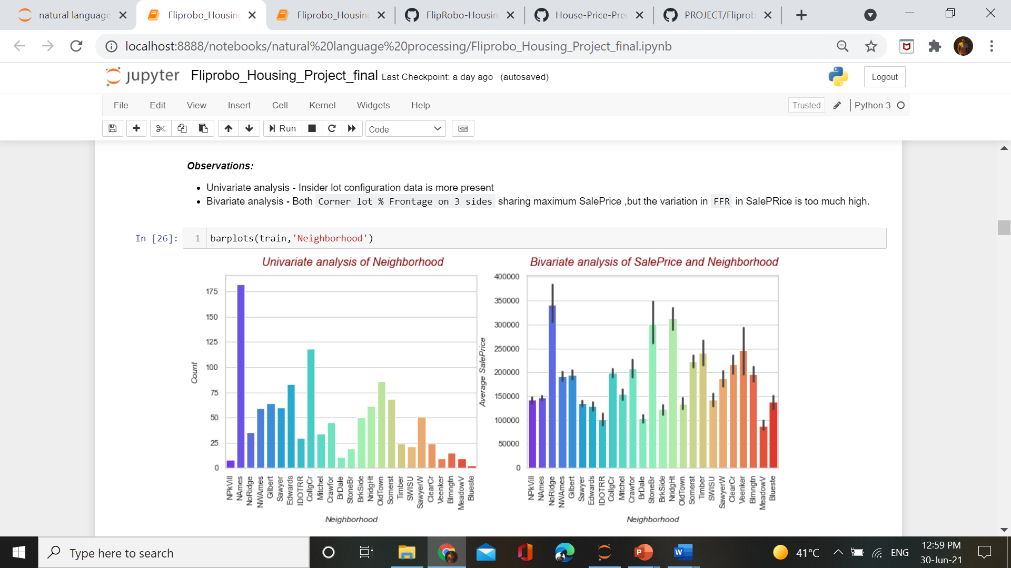
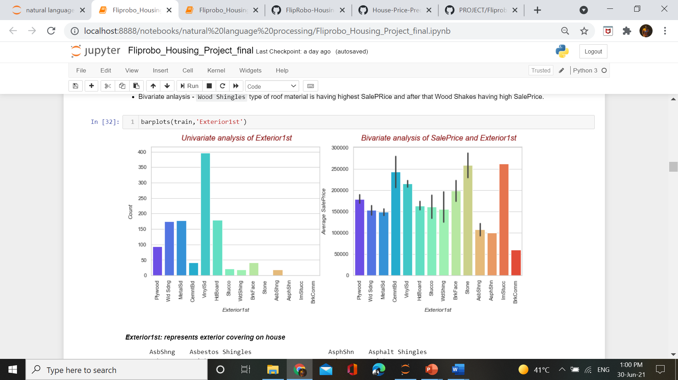
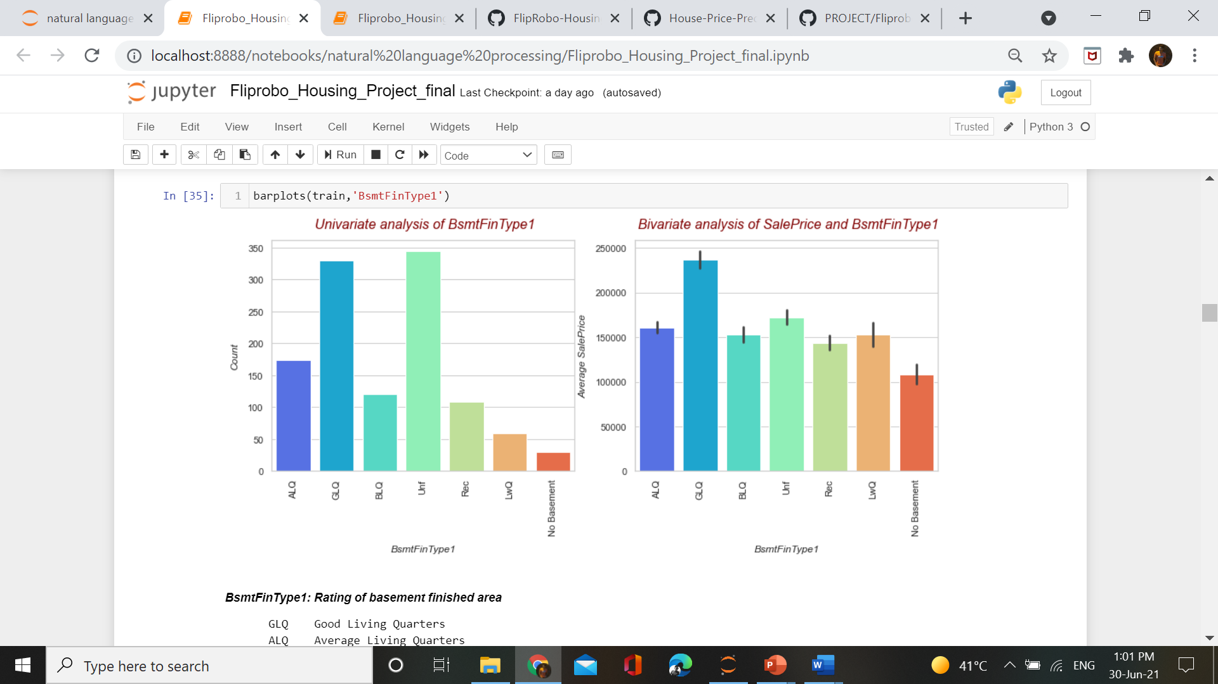
Categorical data analysis

Slide 38
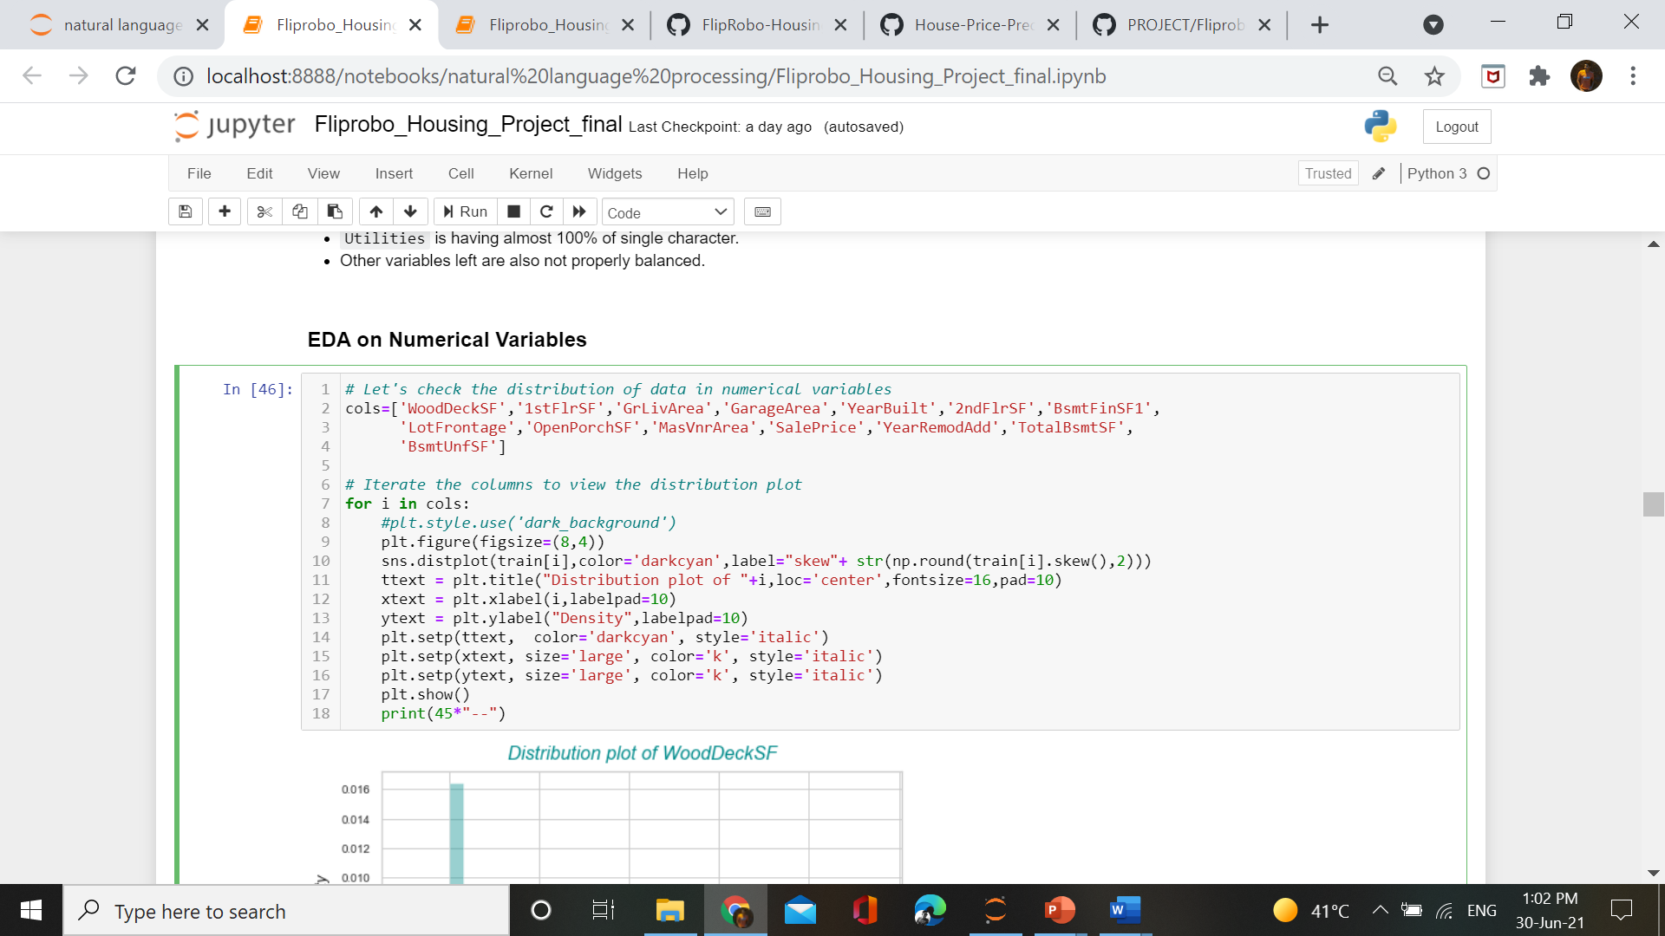
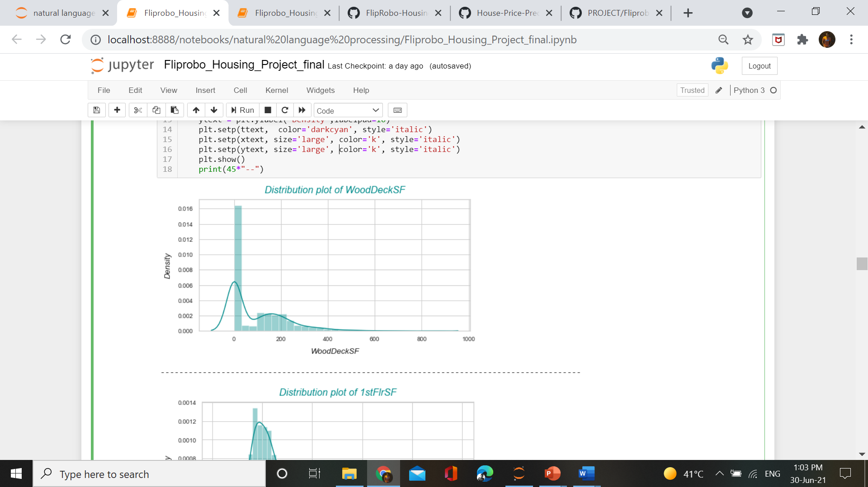
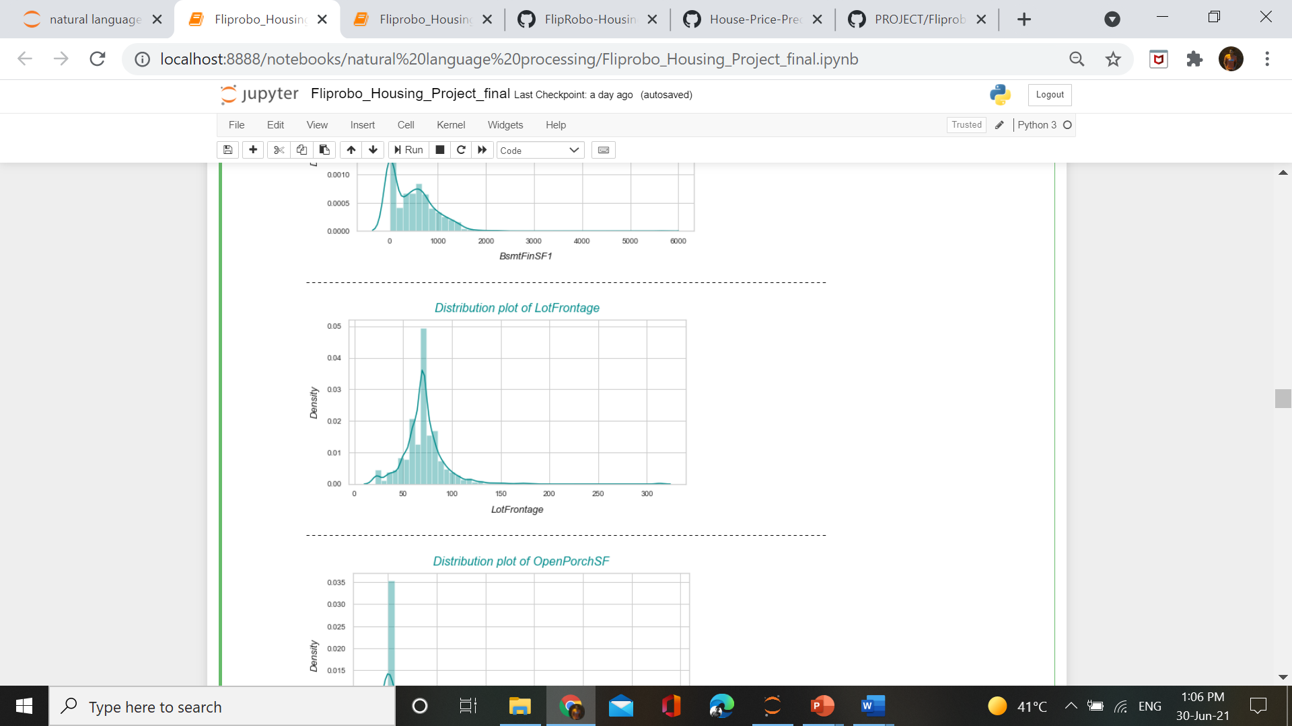
Numerical data analysis

Slide 39
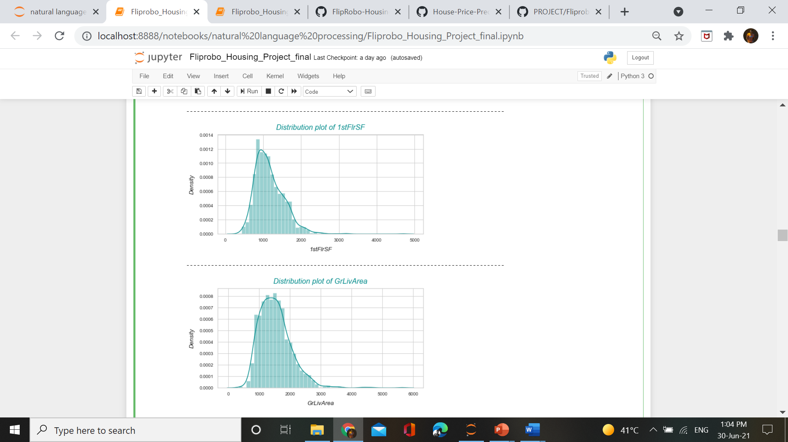
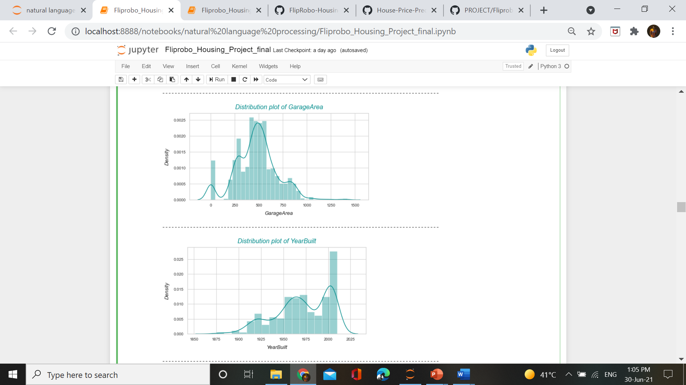

Slide 40
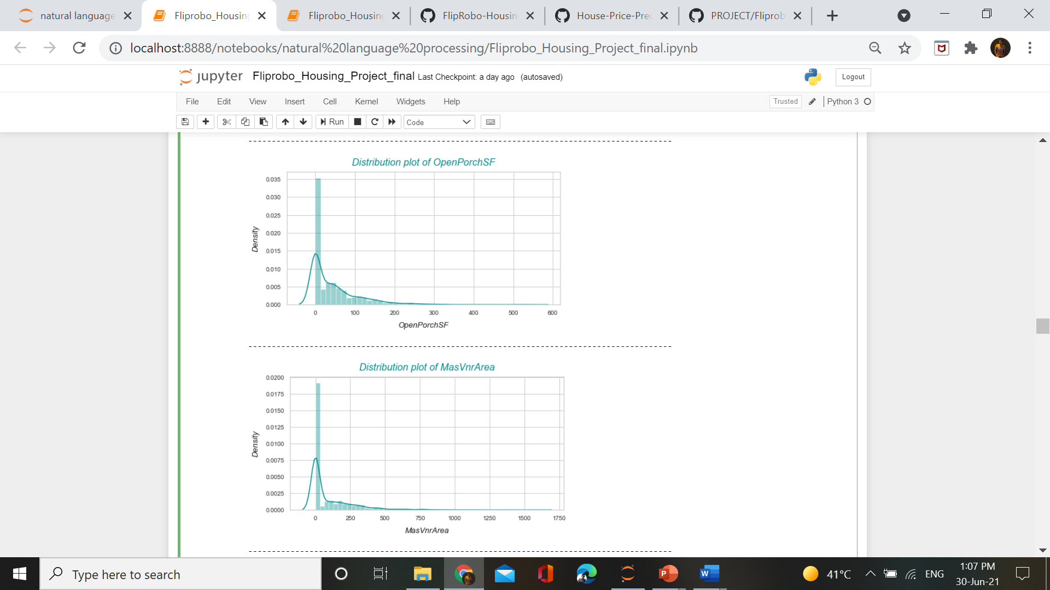
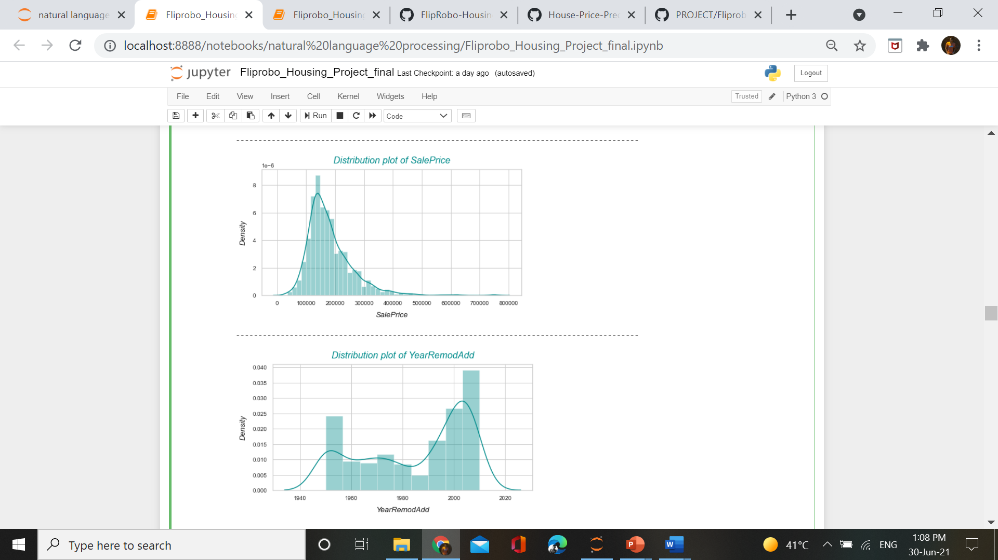

Slide 41
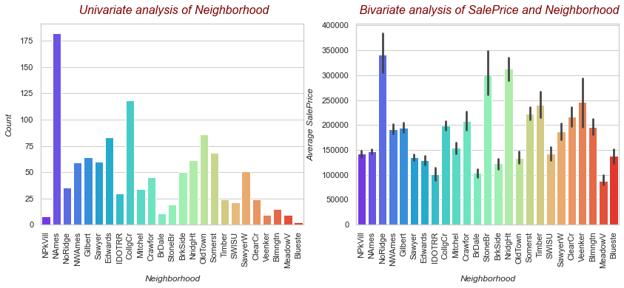
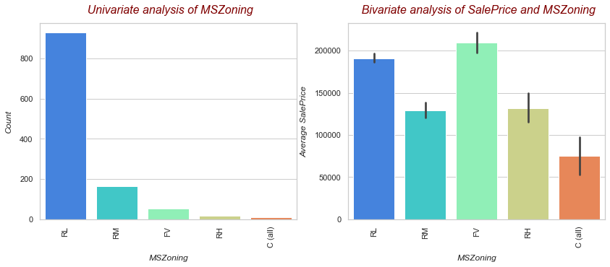
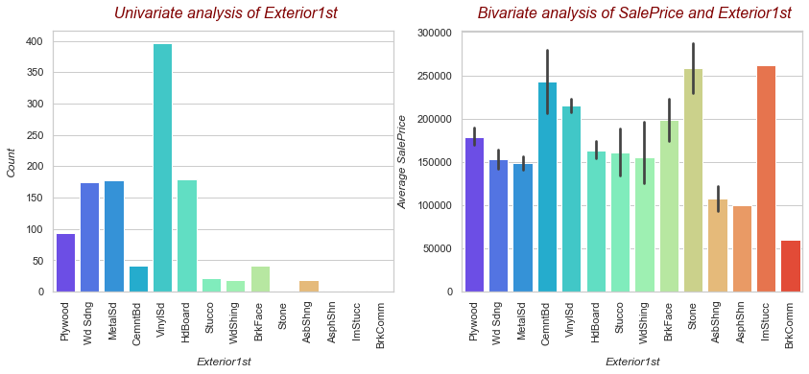
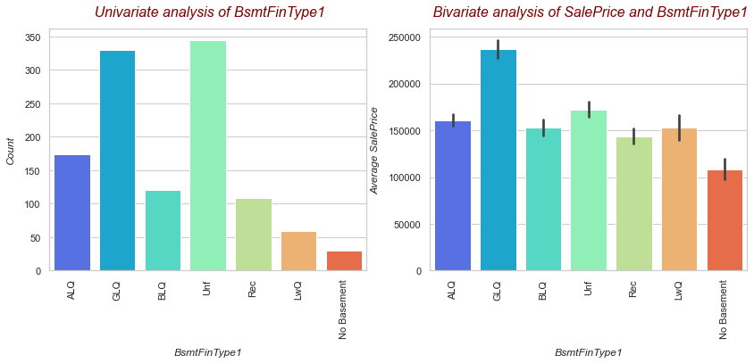
Bivariate categorical analysis

Slide 42
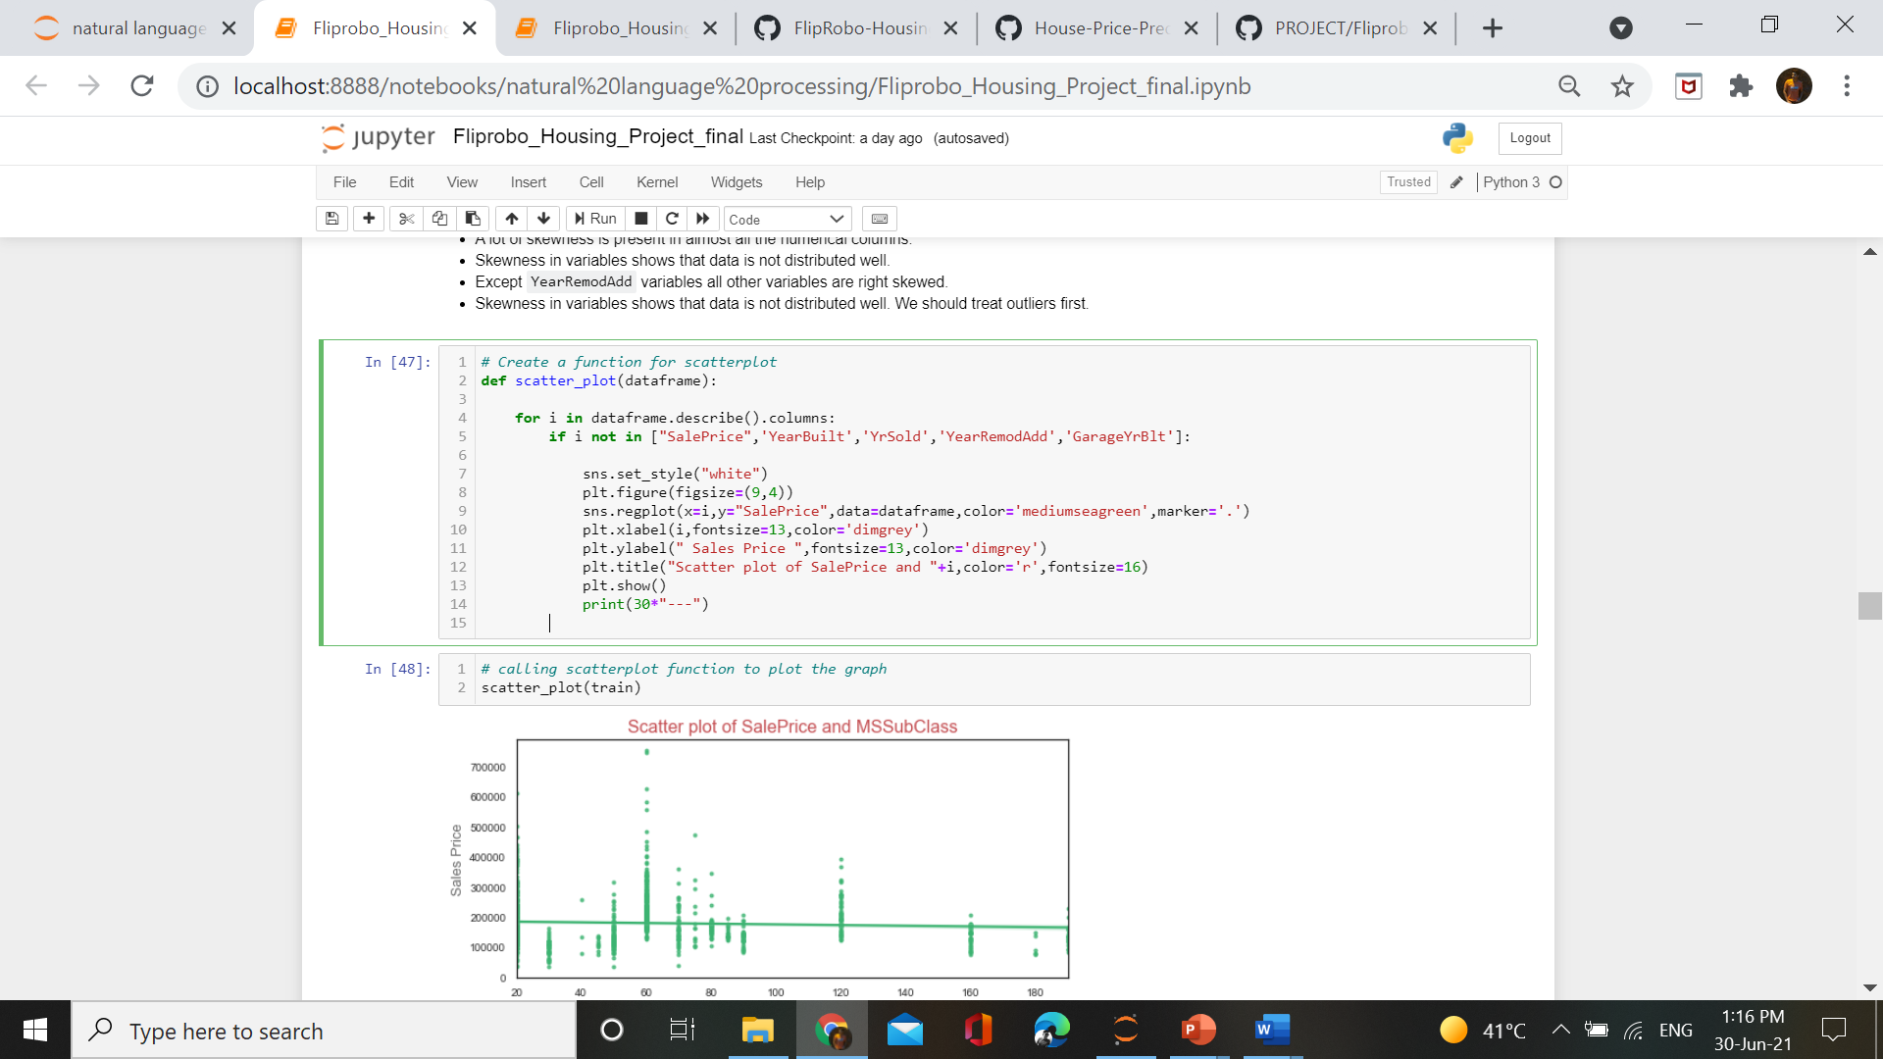
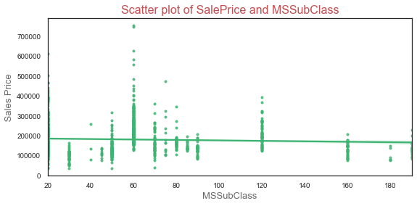
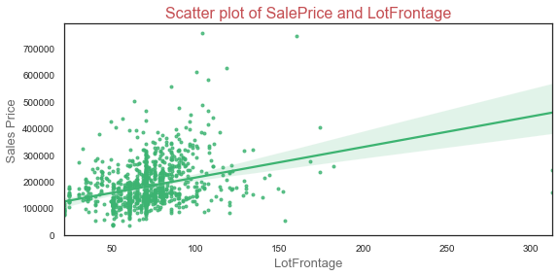
Bivariate numerical analysis

Slide 43
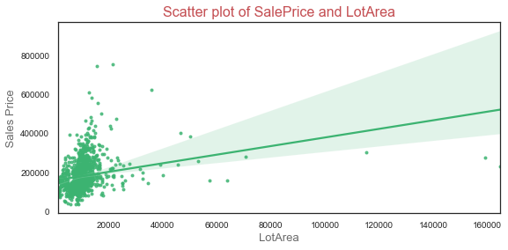
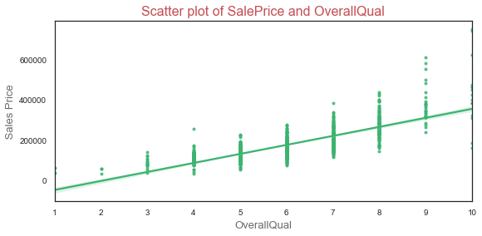
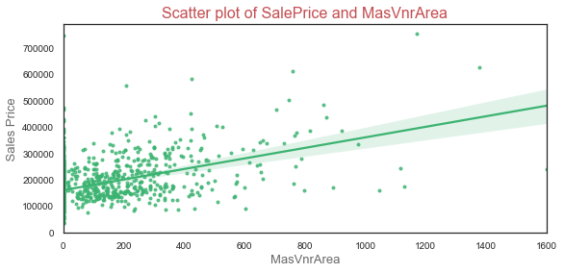
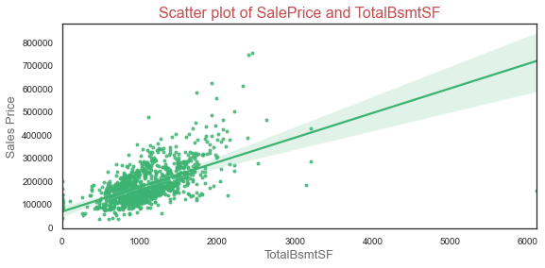

Slide 44
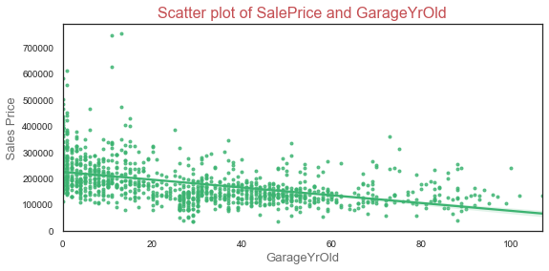
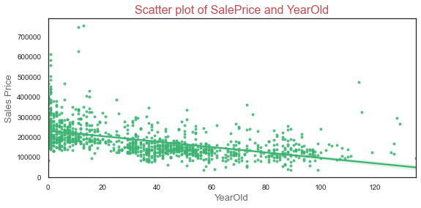


Slide 45


Relation of YearBuilt &GarageBlt with SalePrice
Observations:
* Silver color of line represents the trend of `SalePrice` on the basis of `YearBuilt`.
* While blue color of line represents the trend of `SalePrice` on the basis of `GarageYrBlt`.
* Both the lines follow almost same trend which suggest that in most of the cases there is not much difference in Year of house and garage built.
* But from trend line it is aslo clear that before 1900 there were no garage built for cars.

Slide 46


Multivariate analysis
Observations:
* Relation of above 3 variables shows that the if the GridLivArea increase and the OverallQuall also increase than the SalePrice of house is also going to increase.
* All of the 3 variables are in direct relationship which means that any cahnge in GridLivArea or OverallQuall is going to change the SalePrice in the same way.
* House with OverallQuall above 6 are having high saleprice.

Slide 47


Multivariate analysis
Observations:
* GarageArea and OverallQual aslo having direct relationship with SalePrice.
* Less the GarageArea and low OverallQuall of house, the SalePrice will be less and vice-versa.

Slide 48
Model/s Development and Evaluation

Slide 49
Identification of possible problem-solving approaches (methods)
As we all know ,known target data is treated under Supervised Machine Learning Model and Supervised ML models deals with continuous and discrete data type. If our target data is continuous in nature then Regression Algorithms will be used but if data is discrete in nature/categorical data ,then Classification algorithms will be used.
Let’s check our target data for identification of problem-

Slide 50

So seeing the graph we can clearliy that it is a regression problem. We have to deal Regression Algoritms in model building.

Slide 51
Testing of Identified Approaches (Algorithms)
As we have identified which method to use in this dataset, now we are going to test some algorithms and find out which algorithm is giving best result.
Algorithms tested in this project :
1. Linear Regression
2. Lasso Regression
3. Ridge Regression
4. ElasticNet Regression
5. DecisionTree Regression
6. Kneighbors Regression
7. RandomForest Regression
8. AdaBoost Regression
9. GradientBoosting Regression
We have used 9 algorithms in this project, out of which we will find the best one for our model.

Slide 52
Key Metrics for success in solving problem under consideration
Metrics used in model building and testing are –
Mean Absolute Error
Mean Squared Error
Root Mean Squared Error
R2 Score
Model selection methods –
Cross validation Score
Train test split
Randomized SearchCV

Slide 53



Run and Evaluate selected Algorithms

Slide 54





Slide 55




Finalised Algorithm

Slide 56
Interpretation of Result
By using various types of algorithms, we find out that GradientBoosting Regression is giving better results with minimum Root Mean Squared value of 25949.5 and R2 Score of 89.5% which is quite good comparing others.
Checking the cross validation score of GradientBoosting Regression ,we can confirm that this algorithm will be good for our model.
Further through Hyperparameter tunning ,we tried to increase the efficiency of our selected algorithm.

Slide 57


Visualization of Actual data & Predicted data

Slide 58
CONCLUSION

Slide 59
Key Findings and Conclusions of the Study
The key finding of the study is data there are a lot of factors which affects the price of a house.
Dealing with the Australian house data we find out that some of the major factors responsible for the high price of a house is Overall Quality of house, Garage area of House, GridLiving Area of house, Age of House and many more.
While understanding the categorical variables we find out that house with Wooden Finish on rooftop and Stone & Imitation Stucco on Exterior of house also have high price.
Some other factors responsible for high saleprice are :-
Paved drive way is better preferred by people.
Builtin garage type
Good exposure of Basement
Typical functionality of warranty
Standard circuit breakers used in electrical work
Gas used in heating
Foundation of Concrete
While neighbourhood in “NoRidge, StoneBr ,nindgHt”
All these are factors in property helps in high sale price of house.

Slide 60
Learning Outcomes of the Study in respect of Data Science
This problem contains 81 columns among them some are irrelevant so I drop them and use remaining columns for model prediction. I also check null values in this dataset and make proper arrangement for that. I try to understand this problem by using various visualisation plots like bar plot, box plot, count plot etc. I have scaled the data and them send them into the model. In this problem the GradientBoosting Regression is performing very well according to its cross validation score and r2 score. We also use hyperparameter tunning on this algorithm and find the best result out of it.

Slide 61
Limitations of this work and Scope for Future Work
It was a wonderful experience on working on this project. This project helps a lot in understanding new concepts and the new way of look towards the data but there are some limitations also in this project.
Too many columns – due to many columns it takes more time to understand and visulaize the data .
A lot of missing values – We can gain more efficiency from the model if soo much missing values not be there.
Some columns contains many charaters which also decrease the efficiency of model.
Outliers – Treating outliers means changing the real data which is also not the ideal condition. As much as the real clean data be there , the model will perform well.
Scope –
This data helps a lot in understanding the conditions on which the price of a house depends. Now this model can be by companies for finding the best deal for their customers and helping them to expand their business and also will help people in finding their dream house in their budget.

Slide 62
ThankYou

